Slide 1
GESTURE BASED CONTROL
PROJECT ID: 18
BY,
2012105510 – ARVIND M
2012105515 – DEEPAK S
2012105516 – DEEPAK S
2012105541 – KARTHIKRAJA S

Slide 2
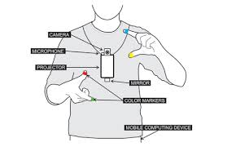
OBJECTIVE
To link the Digital and Real worlds by means of gesture in order to ease the means of communication.

Slide 3
PROBLEM STATEMENT
Identify the gesture and utilizes it to control various applications in a digital device.
Cost effective and also facilitates easy portability.

Slide 4
PROBLEM THAT CAN BE SOLVED
Resolves the need to have a screen to interact with the digital world, projector helps to display the information on any surface.
Resolves the use of a restricted screen to interact with more natural gestures.
Have a more completely portable desktop computer. Wearable technology.

Slide 5
TOOLS REQUIRED
Camera
Projector
Tapes/Rings of different colours for gesture recognition from finger tips
Raspberry Pi – responsible for processing of operations (except the OCR)
Battery Li-ion 10000mAh – 5V 2A
External Server to run the OCR
Wireless transmitter to exchange data between the Raspberry Pi and the OCR running server

Slide 6
HARDWARE SPECIFICATIONS
PROJECTOR:
Ultra Bright 25 Lumens, HD Resolution
Mini-HDMI, 16:9 Compatible ratio, Built-in Speakers, Micro SD, A/V connection, USB reader
Portable 80 Minute built-in battery.
Up to 60 inch Image
CAMERA
USB Webcam

Slide 7
RASPBERRY PI
Broadcom BCM2835 SoC CPU
700MHz Low Power ARM1176JZFS Processor
512MB SDRAM
Boots from Micro SD card, running a version of Linux OS.
85x56x17mm Dimensions.
10/100 Base-T Ethernet socket
HDMI A/V output
Micro USB socket 5V,2A

Slide 8
SOFTWARE SPECIFICATIONS
PYTHON
Python 3.4.3 with NumPy.
OPENCV
Version 3.0.0
OCR
Tesseract 3.0.3
LINUX OS:
Raspbian - Version 7 “Wheezy”

Slide 9
BLOCK DIAGRAM:
CAPTURE IMAGE ON GESTURE
USE OCR AND GET DIGITAL TEXT
TRACK FINGER TO KNOW WHICH KEY IS PRESSED
ZOOM IN & ZOOM OUT
SWIPE & SELECT PICTURE
TRACK THE FINGER TIPS
TAKE PICTURE OF TEXT
PROJECT KEYBOARD ON SCREEN
CALIBRATE
GO INTO GALLERY
INPUT FROM CAMERA

Slide 10
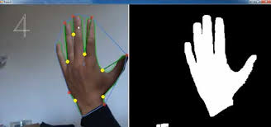
CALIBRATION
Using camera capture the image.
Identify the position as well as the length of the finger.
Fixing the threshold accordingly thereby for further modes of operation.

Slide 11
MODES OF OPERATION
CAPTURING IMAGE
BROWSING IMAGES
KEYBOARD TYPING
OCR FROM BOOKS

Slide 12
CAPTURING IMAGE
Identification of gesture defined by finger tips for capturing image.
Launch camera and take picture specified within the frame of the fingers.

Slide 13
BROWSING IMAGES
Identify the gesture defined for browsing images.
Images are browsed by the movement of the finger.
Image can be zoomed in or out based on finger tip action.

Slide 14
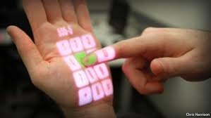
KEYBOARD TYPING
Identify the gesture defined for keyboard projection.
Identify the character pressed in the keyboard.
Store it and display on the same screen.

Slide 15
OCR FROM BOOKS
Switch to the OCR mode of operation by the gesture defined for it.
Position the required text.
Overlay a green box if text is positioned correctly.
Picture of it is taken and sent to the server.
OCR algorithm works on the received image and displays the characters present in it.

Slide 16
TIMELINE(WEEKLY BASIS)
Gathering information required by the project such as the various components, tools and software being used in the project.
Familiarising with the concepts and algorithms
Tracking coloured objects using image processing.
Devising the calibration mechanism for the user’s hand.
Implementing the process of image capture through gesture.
Creating the gallery for viewing pictures captured.
Implementing the gallery gesture functions.
Begin work on the Keyboard module. Identification of the key selected.
Work on Keyboard module.
Begin with OCR – familiarising with the algorithm.
Mapping gesture (finger) trajectory to characters.
Work on OCR.

Slide 17
THANK YOU

